Slide 1

Early Attrition Alerts Business Services Batch Model
Autumn Li
1/12/2021

Slide 2


Why Early Attrition Alerts?
Statistics empowers us to predict which accounts are more likely to attrite
Attrited accounts share similar characteristics
The sales team reaches out to batch accounts that receive attrition alerts and do their best to prevent them from attrition.

Slide 3
What does the attrition model tell us about our batch customers?
Customers with declining trends on transaction usage or the number of active users are highly likely to attrite.
Customers with missing transaction months in past 3 months are more likely to attrite.
Customers with account issues are more likely to attrite.
Customers who have been on the books for a long time are less likely to attrite.
Customer who didn’t meet the minimum usage commitment are more likely to attrite
* Above customer behaviors are based on the attribute characteristics from the statistical model

Slide 4
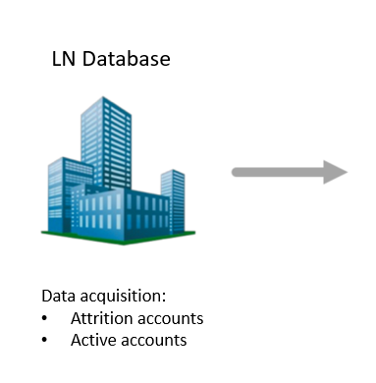
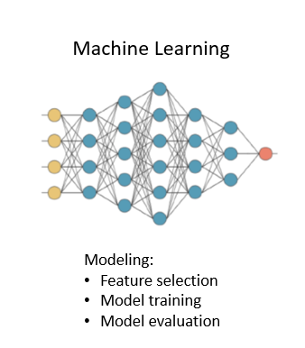
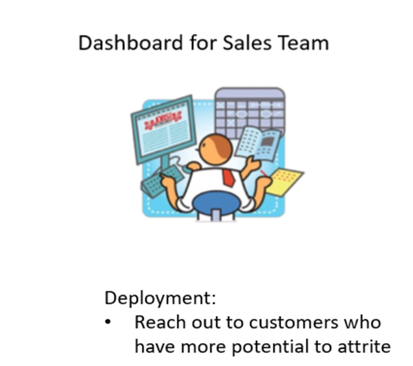

Modeling Process

Slide 5
Batch Customers: Population Waterfall
Whole population
Batch Customers | Active Customers | Attritor Customer
All batch customers created before Sept, 2020 * | 1,384 customers | 399 customers
Criteria 1 - Excluded platform in 'BRG', 'WCI', 'WCO' | 1,384 customers | 339 customers
Criteria 2 - At least 12 months on books | 1,356 customers | 320 customers
Criteria 3 – Active/Attrition year and month is between (201809, 202009) | 1,284 customers | 288 customers
Criteria 4 - Have 12 months total revenue > $500 | 1,141 customers | 245 customers
Criteria 5 - Have 12 months total usage > 0 | 1,078 customers | 220 customers
Population criteria
Target
Valid target batch customers | 1,078 customers | 220 customers
75% Training
1,298 Total Customers
Total valid batch customers | 1,298 customers
75% training customers | 973 customers
25% testing customers | 325 customers
25% Testing

Slide 6


Batch CustomerPopulation Characteristics
Average usage
Average active user
Average customer age
31,255 searches
5 active users
3,779
Days
(9 Years and 3 Months)
Active batch accounts
9,084 searches
2 active users
2,507
days
(6 Years and 10 Months)
Attrited batch accounts

Slide 7

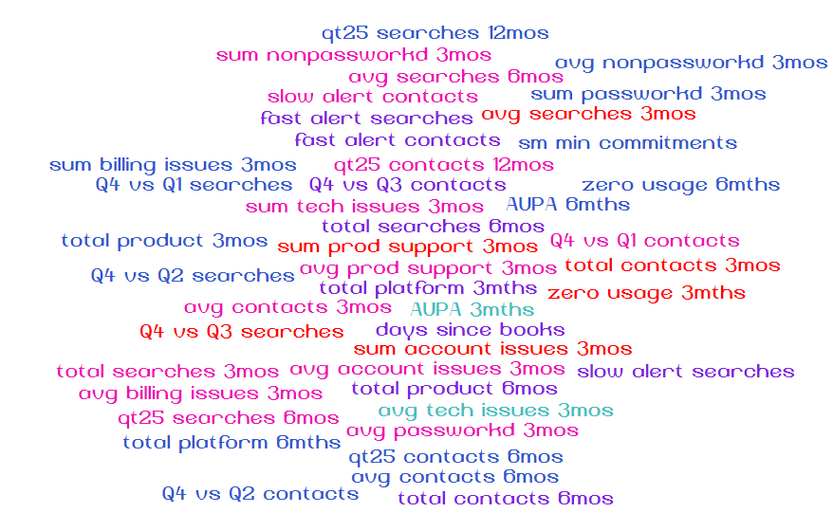
Variable creation and selection
With 51 behavior features, how to find the important ones?

Slide 8
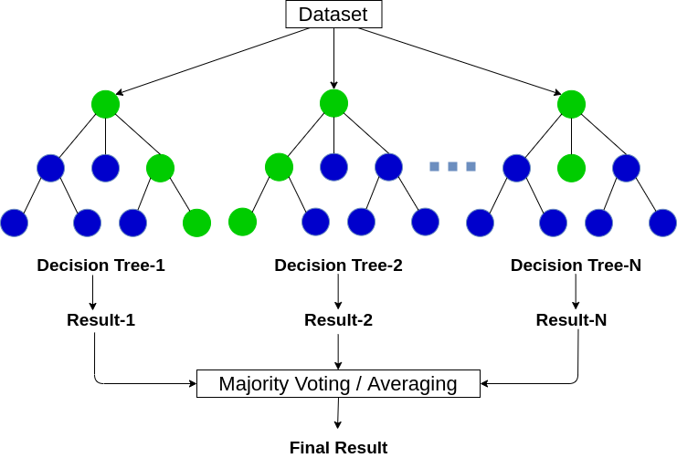
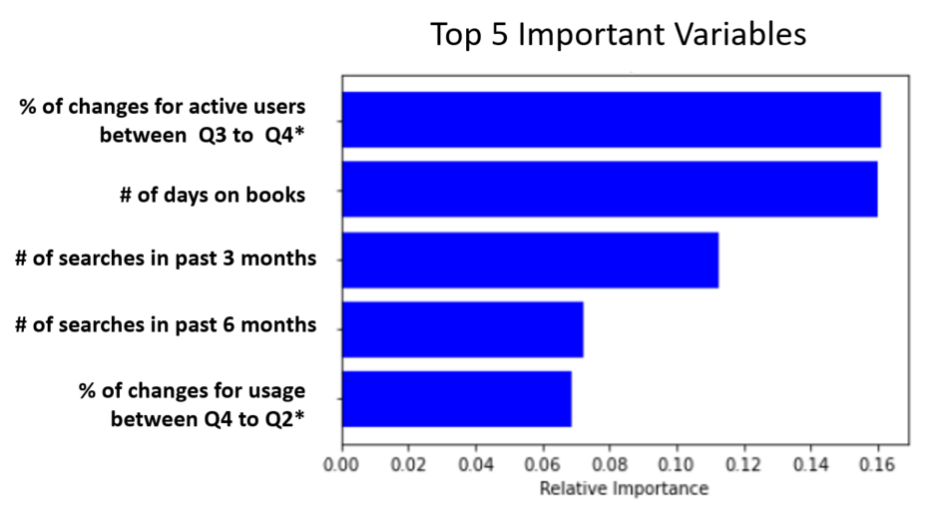
Variable selection
Random Forest Variable importance ranking
How it works?
Random forests (RF) construct many individual decision trees at training.
Feature importance is calculated as node probability
The node probability can be calculated by the number of samples that reach the node, divided by the total number of samples. The higher the value the more important the variable.
*Q3 stands for the 3rd quarter, Q4 stands for the 4th quarter, Q2 stands for the 2nd quarter

Slide 9
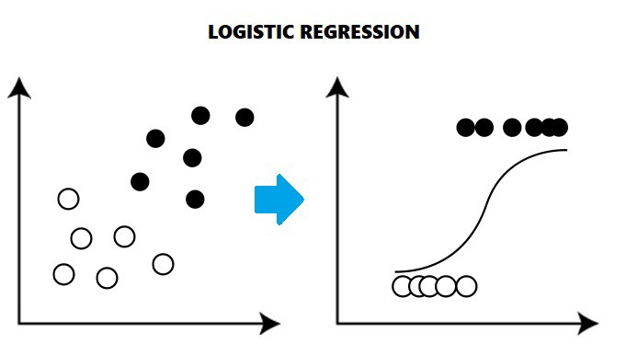
Modelling
Traditional logistic regression
A basic statistical model to predict binary dependent variables, such as active accounts and attrited accounts
Machine learning –XGBoost
A highly flexible machine learning algorism that can work through most regression and classification
XGBoost
Extreme Gradient Boosting
Custom tree building algorithm
Interfaces for Python and R
Classification
Regression
ranking

Slide 10
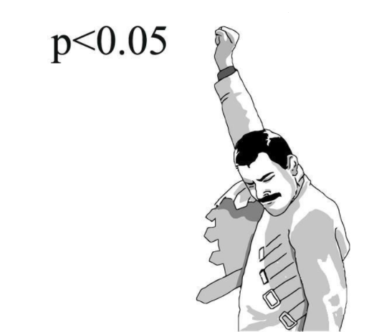
Modelling-Logistic Regression Results
Variable | Z-value | P>|z|
% of changes for number of active users between 3rd quarter to 4th quarter | 7.418 | 0
Number of months without any usage in past 3 months | 4.004 | 0
Number of days since the account has been created | -3.995 | 0
Total number of products in the past 3 months | -3.073 | 0.002
Number of customer service related to account issues | 2.777 | 0.005
Number of customer service related to billing issues | -2.214 | 0.027
If monthly average usage < min commitments (100), alert = 1 | 2.06 | 0.039
Decline of transaction usage* | 2.041 | 0.041
Total usage in the past 3 months | -1.38 | 0.165
* % difference between average Transaction Usage in 3 months leading up to attrition date and bottom 25th percentile of Transaction Usage over time

Slide 11
Logistic Regression Results Interpretation
Behaviors | Variable | Less likely / More likely to attrite
Active users change | % of changes for active users from 3rd quarter to 4th quarter | More changes, more likely to attrite
Abnormal small usage | Number of months without any usage in past 3 months | More months without any usage, more likely to attrite
Customer age | Number of days since account creation date | More number of days on books, less likely to attrite
Product diversity | Total number of products in the past 3 months | More number of products, less likely to attrite
Customer service | Number of customer service relates to account issues | More number of account issues, more likely to attrite
Customer service | Number of customer service relates to billing issues | More number of billing issues, less likely to attrite
Abnormal small usage | If monthly average usage < min commitments (100), alert = 1 | More abnormal small usage, more likely to attrite
Declining negative customers | The decline of transaction usage* | More decline of usage, more likely to attrite
Customer usage | Total usage in the past 3 months | More searches, less likely to attrite
* % difference between average Transaction Usage in 3 months leading up to attrition date and bottom 25th percentile of Transaction Usage over time

Slide 12


Logistic Regression Model Evaluation
Decile | # Attritors | # Non Attritors | Total # Testing Customer | Attrition Rate
1 | 15 | 18 | 33 | 23.44%
2 | 13 | 19 | 32 | 20.31%
3 | 10 | 23 | 33 | 15.63%
4 | 7 | 25 | 32 | 10.94%
5 | 5 | 27 | 32 | 7.81%
6 | 3 | 30 | 33 | 4.69%
7 | 4 | 28 | 32 | 6.25%
8 | 3 | 30 | 33 | 4.69%
9 | 3 | 29 | 32 | 4.69%
10 | 1 | 32 | 33 | 1.55%
Total | 64 | 261 | 325 | 100%
More likely to leave
How To Read this Chart:
Attrition model scores every customer based on likelihood of leaving
Customers are rank ordered based on scores and placed into deciles (Decile 1 = most likely to leave LN)
Actual counts of Attritors and Non-Attritors are used to gauge the performance of the model

Slide 13
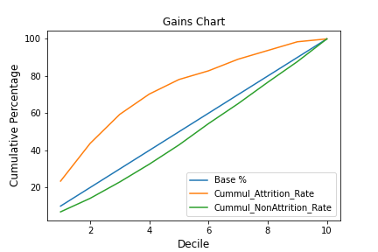
Logistic Regression Model Evaluation
70.31%
KS = 37.74
32.57%

Slide 14
Modelling-XGBoost
XGBoost
XGBoost implements the algorithm for decision tree boosting with an additional custom regularization term in the objective function
Boosting is a sequential technique which works on the principle of an ensemble. It combines a set of weak learners and delivers improved prediction accuracy
Decile | # Attritors | # Non Attritors | Total # Customer | Attrition Rate
1 | 19 | 14 | 33 | 29.69%
2 | 11 | 21 | 32 | 17.19%
3 | 8 | 25 | 33 | 12.50%
4 | 5 | 22 | 27 | 7.81%
5 | 7 | 30 | 37 | 10.94%
6 | 6 | 23 | 29 | 9.38%
7 | 2 | 33 | 35 | 3.12%
8 | 1 | 32 | 33 | 1.56%
9 | 4 | 29 | 33 | 6.25%
10 | 1 | 32 | 33 | 1.55%
Total | 64 | 261 | 325 | 100%
More likely to leave

Slide 15

Modelling-XGBoost
59.36%
KS = 36.37
22.99%

Slide 16

Model Deployment- Salesforce

